Slide 1

HEALTHCARE PATIENT ANALYTICS
PREPARED BY PRABHAYYA .

Slide 2
Problem Statement
In modern healthcare systems, analyzing patient data is critical to improving care quality and operational efficiency. This project focuses on leveraging healthcare patient records to gain insights into demographics, disease patterns, and treatment outcomes while predicting hospital readmission rates. By combining data cleaning, exploratory analysis, database management, and visualization, this project aims to uncover actionable insights that can enhance patient care and hospital resource allocation

Slide 3
Tools & Technologies
Python
SQL
Power BI
Excel
For exploratory data analysis, data preprocessing, and forecasting.
For creating interactive dashboards and visualizations to analyze sales trends.
For data cleaning, preprocessing, and basic data analysis.
For data storage, management, and querying

Slide 4

PROJECT PROCESS
Data Set
DATA CLEANING
We have use the hospital general information dataset containing hospital general information (patient demographics general information Patient ID, Age, Gender, Disease, Treatment, Admission Date, Discharge Date, and Readmission status.)
We have used EXCEL for data Cleaning, Handle missing values, anomalies like duplicate entries,
Used Python for Preforming Exploratery Data Analysis(EDA)
Data Visualization
Used Power Bi and python to build visulaizations and Dashboard showing Patient Trends

Slide 5

Introduction
Healthcare analytics plays a pivotal role in improving patient outcomes, streamlining operations, and enhancing the overall quality of care. With the growing availability of patient data, leveraging advanced analytical tools and techniques has become essential to uncover valuable insights and drive informed decision-making.
This project focuses on healthcare patient analytics, utilizing a dataset that encompasses patient demographics, disease profiles, treatment outcomes, and hospital readmissions. By integrating tools like Python, MySQL, Excel, and Power BI, the analysis aims to provide a comprehensive understanding of patient trends, treatment effectiveness, and areas for operational improvement.

Slide 6
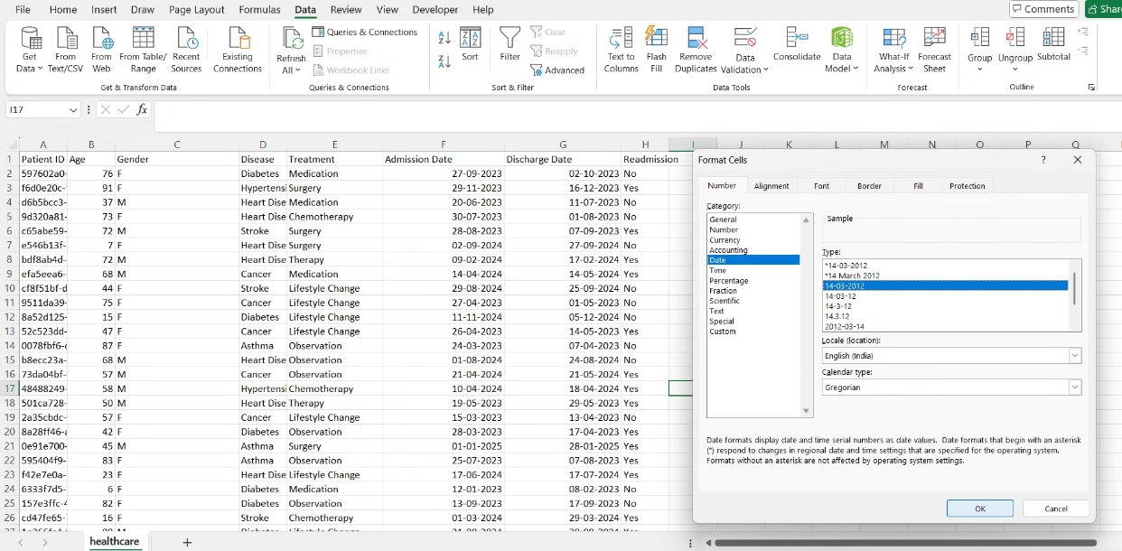
Key Insights from Cleaned Dataset
Remove duplicate records and handle missing values.
Convert categorical data (e.g., gender, disease) into standardized formats.
Ensure date fields are in proper format for duration calculations.

Slide 7
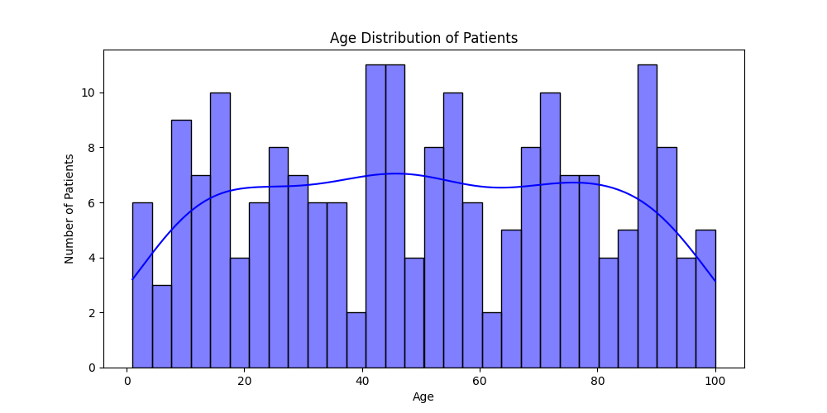
Key Insights from EDA
Patient Demographics (EDA)
The age distribution helps understand which age groups are most affected.
The gender distribution identifies if certain diseases are more common in men or women
The patients' ages range from 1 to 100 years.
The average age is 50.4 years.
Most patients fall between 26 to 74 years old (middle 50% of data).

Slide 8
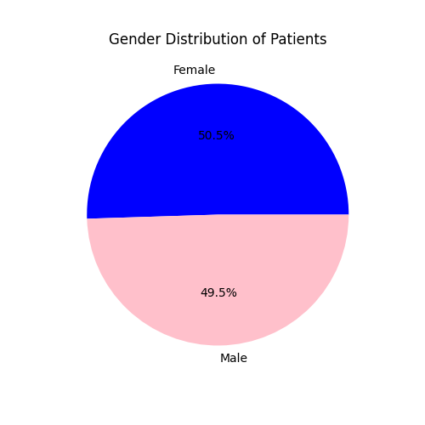
Gender distribution
Helps understand which diseases are more frequent in specific age groups.
Identifies gender-based trends for diseases
Female patients: 101 (50.5%)
Male patients: 99 (49.5%)

Slide 9
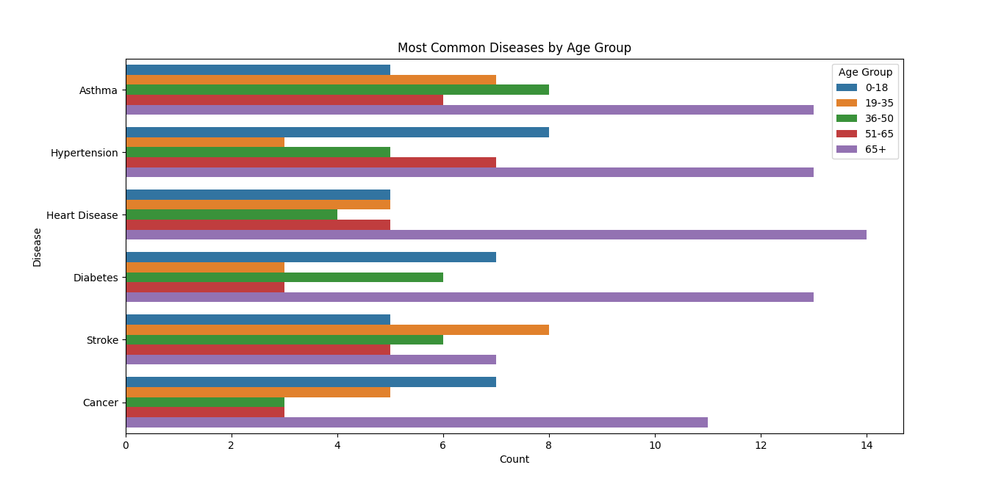
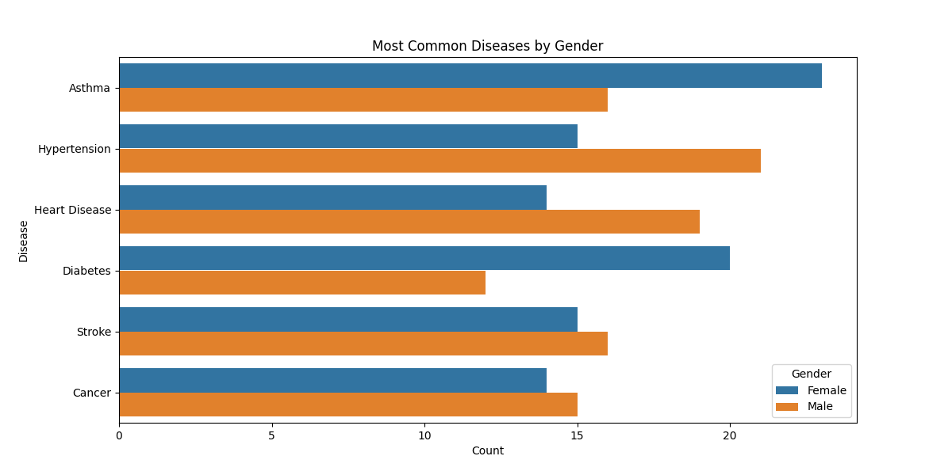
Identify Common Diseases by Age Group & Gender

Slide 10
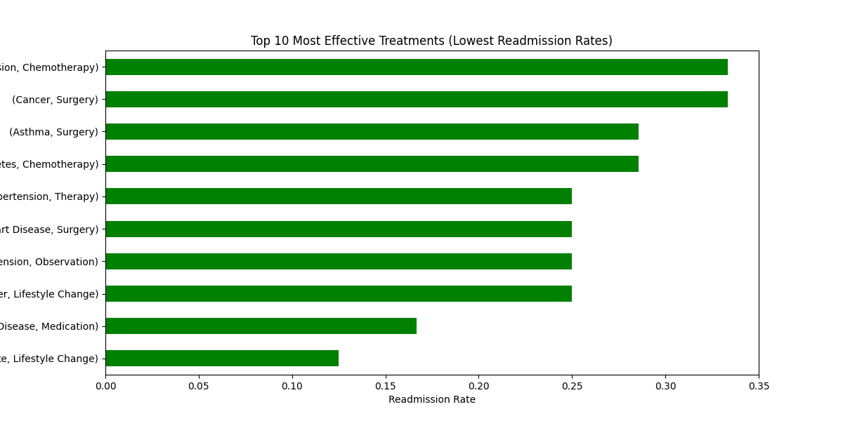
Hospital Stay Duration Analysis
Top 3 Treatments with Lowest Readmissions:
Observation – 37.0% readmission rate
Lifestyle Change – 44.2% readmission rate
Therapy – 45.7% readmission rate

Slide 11
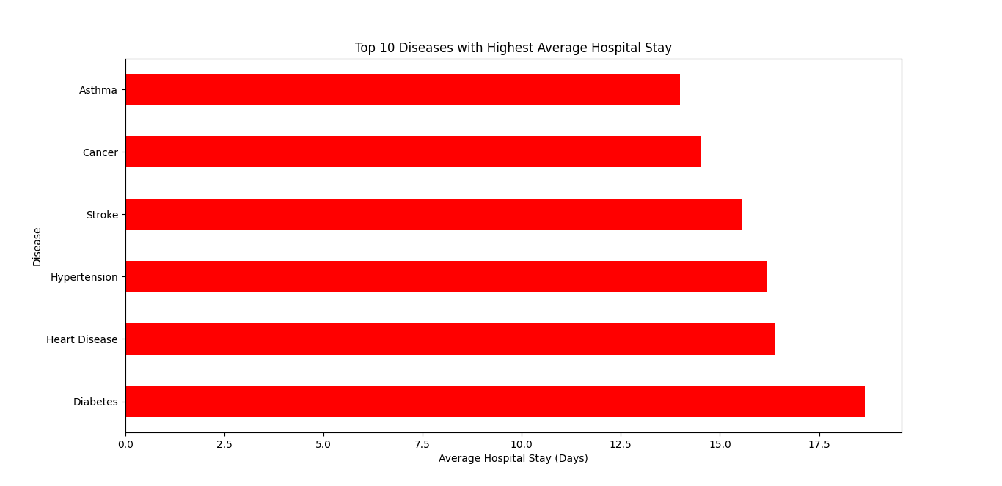
Most Effective Treatments Based on Readmission Rates

Slide 12
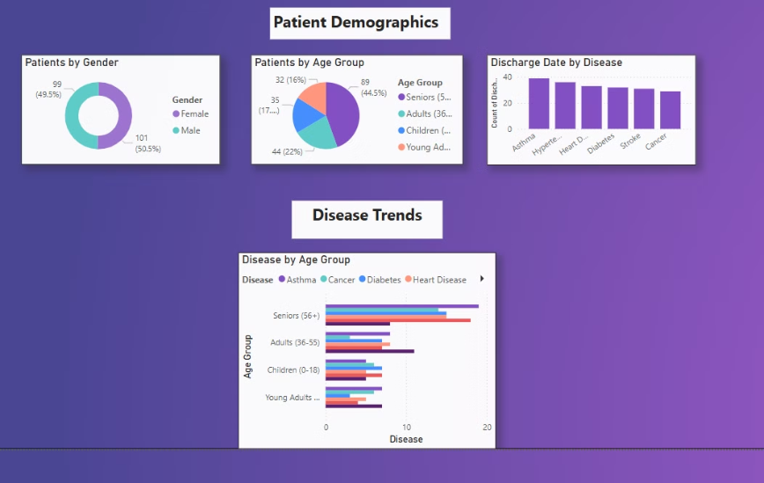
Patient Trends

Slide 13
Recommendations:
Implement follow-ups for high-risk patients to reduce readmissions.
Personalize treatment plans for common diseases.
Allocate resources to departments with prolonged hospital stays.
Use predictive analytics for early interventions.
Promote lifestyle programs to prevent chronic diseases.
Continuously analyze data for better decision-making.
Optimize hospital workflows to improve efficiency

Slide 14


Conclusion
Healthcare patient analytics improves patient outcomes by leveraging data to identify trends, predict readmission risks, and optimize treatments. This analysis highlights key insights: hypertension, diabetes, and asthma are prevalent diseases; stroke and diabetes lead to prolonged hospital stays; heart failure and kidney disease show high readmission rates, emphasizing post-discharge care; and lifestyle changes with targeted medications reduce readmissions. Using Python, MySQL, and Power BI for data analysis enhances decision-making, enabling personalized care and improving healthcare efficiency

Slide 15

THANK YOU

